Slide 1





SAFE CALLING
& TEXTING
Safeguarding Our Digital World
Notes:
Omya

Slide 2

Icebreaker :
Raise your hand if you’ve blocked a spam call or labeled one as junk this week
Notes:
Omya
After they raise their hands, ask "Did it work? Did it stop?"

Slide 3





Understanding Modern Call Settings
For both iPhone & Android, there is an option for automatically silencing unknown callers that aren’t in your contact list.
iPhone:
Android:
When this option is turned on, all calls from Messages, Contacts, and Mail will all automatically go to voicemail
It’s important to note that there will be a missed call notification, but your phone won’t ring to notify you of that call at that moment.
This is a great option for avoiding scam, or robot calls, but you might miss actual important calls from doctors, new contacts, delivery drivers, and etc.
To turn on: Navigate to Settings > Phone > Silence Unknown Callers and toggle the switch to the On position.
For Android, there is a similar setting called Filter spam calls or Silence unknown numbers.
This is very similar to the structure of iPhone, but unknown numbers may be silenced, or a Google Assistant-style feature may screen the call for you
To turn on: Navigate to the Phone app settings, then select "Block numbers" or a similar option. Toggle on the "Block unknown callers" or "Silence unknown callers" feature
Notes:
Poornasai

Slide 4


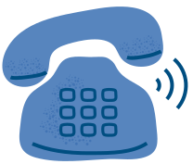
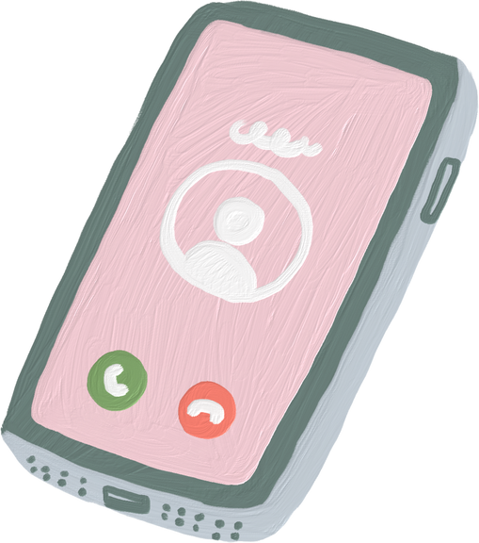
Difference between blocking, silencing, and filtering calls
Blocking Callers
This number cannot call, text, or videocall you at all unless you manually unblock them yourself
Silencing Callers
Only the numbers that are NOT in your contact list are sent to voicemail
You still get the notification of the call, but your phone just wont ring and notify you of the call at that moment
Filtering calls (Google Call Screen):
Google Assistant answers unknown calls for you and shows you a live transcript.
You can decide whether to answer or decline after seeing what the caller says.
Notes:
Cindy

Slide 5
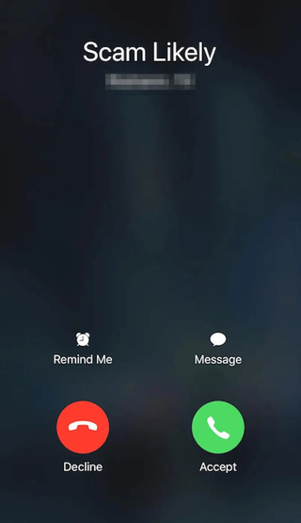

Best Scam Call Detector Apps
These are really useful for when you don’t want to accidently miss important unknown calls, but you specifically just want to know when a scammer is calling you!
True Caller
Easy to use, very minimal set up
It has a very large community based spam list
Hiya
Automatically blocks fraud and scam calls
Trusted by major companies like AT&T and Samsung
RoboKiller
Blocks scam & robot calls and texts
Uses AI to predict and stop spam
FUN BONUS: Includes Answer Bots that waste scammers’ time for you
However, it has a free trial so it’s important to note that it isn’t free
Notes:
Omya

Slide 6



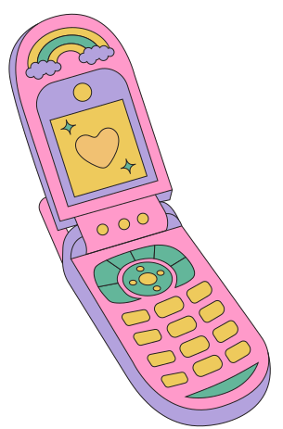
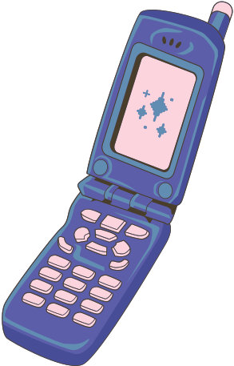
Contact App Permissions
Apps sometimes ask for permission to access our contacts, and we sometimes unknowingly allow it. Allowing this means that they can see the phone numbers, names, and emails we’ve saved. This matters a lot because apps can sell your data, and use personal information!
iPhone:
Android:
Open Settings
Scroll down and tap on Privacy & Security
Tap Contacts
You'll see a list of apps. Switch OFF any that don’t need access
Open Settings
Tap Privacy or Apps & Notifications
Tap Permission Manager or App Permissions
Tap Contacts
Review which apps are allowed; tap to turn OFF access for ones you don’t use
Notes:
Poornasai

Slide 7
Unknown & Spam Texts
These setting instructions below for both iPhone and Android will make it easier to filter out unknown, and can possibly block spam messages.
iPhone:
Android:
For iPhone, this moves texts from numbers that are NOT in your contacts to a separate Unknown Senders tab
This really helps avoid clutter, and potential spam
Navigate to Settings > Messages > Filter Unknown Senders
Android has a specific feature for this
Warns you about suspected spam texts and can block them automatically
Navigate to Settings > Spam Protection
Notes:
Cindy

Slide 8
Reviewing Call History & Voicemail Settings
Lots of missed calls from unfamiliar area codes
Repeated hang-ups or silent voicemails
Voicemails from numbers that don’t match the caller
If you’ve noticed any of the following, it’s probably a good idea to reset your voicemail PIN! This is because hackers can access voicemail if there’s no password or it’s weak, and a lot of us do leave default passwords!
iPhone:
Android:
Contact your carrier or go to Settings
Navigate to Settings > Phone > Change Voicemail Password
Android: Varies by carrier
Usually in the Phone app settings or your carrier’s app
Notes:
Omya

Slide 9
Text Settings Review
Read recipients let the other person know that you have read their message. We can disable these for more privacy!
iPhone:
Android:
Settings > Messages > Send Read Receipts (Toggle on or off)
In individual chat settings or Messages app settings
Previews can make scam links look official (EX. Amazon, banks)
TO TURN OFF PREVIEWS:
Some apps allow disabling in message settings
Always avoid clicking unknown links, even with a ‘nice’ preview
Notes:
Poornasai

Slide 10



Carrier Features
Verizon: Call Filter
Blocks spam, identifies suspicious numbers
Available as an app
AT&T: ActiveArmor
Free for most users
Alerts about fraud calls and blocks known scams
Includes auto blocking and fraud risk labels
T-Mobile: Scam Shield
Caller ID, scam blocking, and number protection
Includes reverse number lookup and voicemail to text
Notes:
Cindy

Slide 11
Emergency Call Settings
iPhone:
Android:
Quickly press the side button 5 times to call emergency services
Automatically alerts your emergency contacts if enabled
Found in Settings > Safety & Emergency
Can call 911, share your location, and alert emergency contacts
Medical Features:
Our phones have the option to add medical information in case of emergencies, like conditions, allergies, medications.
These can be accessed through the lock screen
Set up in Health app (iPhone) or Emergency Info (Android)
Notes:
Omya

Slide 12
Let’s test your knowledge!

Slide 13
1) What does Silence Unknown Callers actually do?
Notes:
Poornasai

Slide 14
It sends non-contact calls to voicemail without ringing. **Doesn’t block**
Notes:
Poornasai

Slide 15
2) Which is better for scam defense - Blocking or Reporting, and WHY?
Notes:
Poornasai

Slide 16
Reporting helps update global databases, helping others. Blocking is personal only.
Notes:
Poornasai

Slide 17
3) What feature helps filter texts from numbers you don’t know?
**Answer in terms of what device you use**
Notes:
Poornasai

Slide 18
iPhone: Filter Unknown Senders
Android: spam protection in Messages.
Notes:
Poornasai

Slide 19
4) What’s a risk of accepting FaceTime/video calls from unknown people?
Notes:
Cindy

Slide 20
Spoofing, phishing setups, or inappropriate content.
Notes:
Cindy

Slide 21
5) What should you watch out for before clicking a link in a text from an unknown number?
Notes:
Cindy

Slide 22
The link could lead to a phishing site or download malware. NEVER click unfamiliar links.
Notes:
Cindy

Slide 23
6) Why should you avoid calling back vague voicemails from unknown numbers?
Notes:
Cindy

Slide 24
Scammers often leave fake messages to trick you into calling back a high-fee or scam line.
Notes:
Cindy

Slide 25
7) Your phone rings with a number similar to yours. You answer and they ask for your Medicare number. What should you do?
Notes:
Omya

Slide 26
Hang up immediately, this is likely a scam. Never give out personal information like your Medicare number over the phone unless you’re 100% sure of who you're speaking to. You can report the number to Medicare or the FTC.
https://reportfraud.ftc.gov/
Notes:
Omya

Slide 27
8) You receive five calls in one day from random cities. What settings might help stop this?
Notes:
Omya

Slide 28
You can enable features like “Silence Unknown Callers” on iPhone or Spam Protection in Android Messages. Also, consider using a trusted spam filter app like Truecaller or a carrier-based solution (e.g., AT&T ActiveArmor, Verizon Call Filter).
Notes:
Omya

Slide 29
9) Your phone carrier offers a free spam filter. Should you use it?
Notes:
Omya

Slide 30
Yes, yes, yes! These tools are designed to automatically detect and block known scam numbers, and they’re regularly updated. Using your carrier’s spam filter adds an extra layer of protection against unwanted or dangerous calls.
Notes:
Omya

Slide 31
Q&A
Notes:
Answering any questions they have!!
Also we will be helping them with their devices if they need any help.

Slide 32
THANK YOU!
Notes:
yay

